Slide 1
Security professional Development
Tips on How to Develop Your Security Staff
John Kemp
Director, Security Services

Slide 2
Overview
Developing a Professional Tool Box
Our Security Community – Where to go for Help
Your Legacy – Your Responsibility
One Perspective

Slide 3
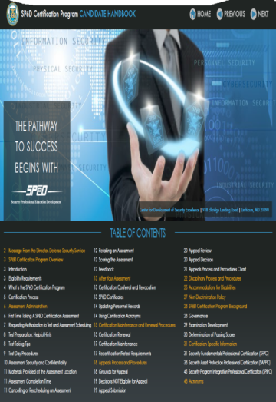
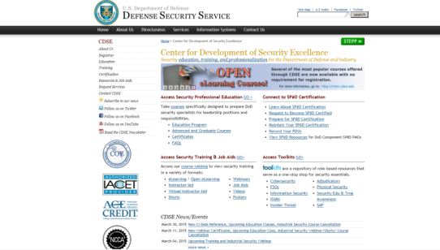
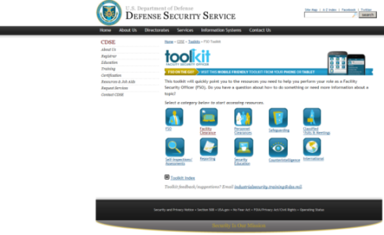
Developing a professional Tool Box
Security Credentials
  Center for Development of Security Excellence

Slide 4
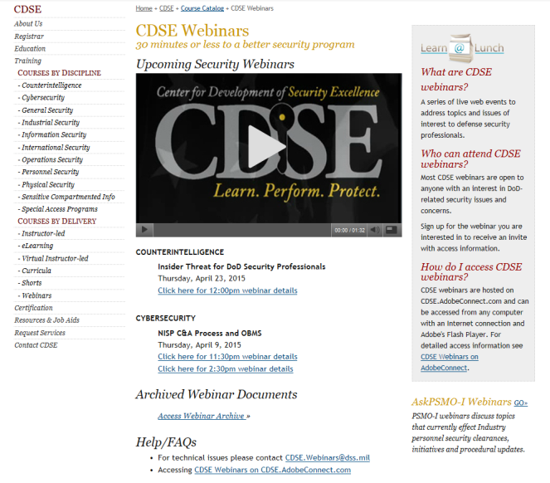
Developing a professional Tool Box
Security Credentials
  CDSE
    Courses, Webinars
      COUNTERINTELLIGENCE
      Insider Threat for DoD Security Professionals
      Thursday, April 23, 2015
      CYBERSECURITY
      NISP C&A Process and OBMS
      Thursday, April 9, 2015

Slide 5
Developing a professional Tool Box
Security Credentials - Resources
  NCMS
  FISWG
Business Credentials – Earning a Seat at the Table
  Understand What Drives your Business
    What the CEO Wants You to Know
    Business Buzzwords - 2015
  Bringing Value – Business Process Engineering
Security Language
Business Language
Insider Threat
Competitive Advantage
Data Spill
mCommerce
Social Media
Conversation Marketing

Slide 6

Developing a professional Tool Box
Don’t Neglect Your Leadership Toolbox
  Effective Leaders Influence their Business Culture
  Business Leader, Security Leader – Leader
  Develop Leadership at all Levels
Leadership is the art of getting someone else to do something you want done because he wants to do it. – Dwight D. Eisenhower
"The greatest leader is not necessarily the one who does the greatest things. He is the one that gets the people to do the greatest things." Ronald Reagan
"Hire character. Train skill." Peter Schutz
"Great leaders are almost always great simplifiers, who can cut through argument, debate, and doubt to offer a solution everybody can understand." Colin Powell

Slide 7
Our security community
Commitment to the National Industrial Security Program (NISP)
  Our Responsibility to our Business, To our Community, To National Security
Mentoring
  Seek Mentors Outside of Security
Exchange of Best Practices to Further the Program
  Business Concern – Protecting your Competitive Advantage vs. National Security
Building Professional Relationships
  Today
  NCMS

Slide 8

Your legacy – Your Responsibility
It is Bigger than Developing Your Career
  We have an obligation to develop our Bench Strength
  We have an obligation to develop our Next Generation Security Professional
Our Responsibility to Employee Development
Succession Planning - No Matter the Size of the Organization
  Business Imperative – Personal Imperative

Slide 9
One perspective
Creating a Culture – Professionalization of our Career
Talent Assessment and Talent Pipeline
  Early Career vs. Experienced Professional Hiring
  Security Leadership Development Program
  Growing Security Professionals from Within
Talent Development
  Formal Learning Plans
  Learning through Osmosis – Create a Culture of Sharing
  Security Professional Calls
  Webcasts
  Security Leadership Conference
  Connect Security
  Working Groups
  Rotational Assignments
Talent Reviews
  Succession Planning
  Identification of High Potential Security Professionals
  Unique Skills (Subject Matter Experts)

Slide 10
Questions
Thank You !

